Slide 1
A Collision Avoidance Software Designed For The Blind
Team A1_01
Xufeng Shen, Zhiao Zhou, Wenxin Zu

Slide 2
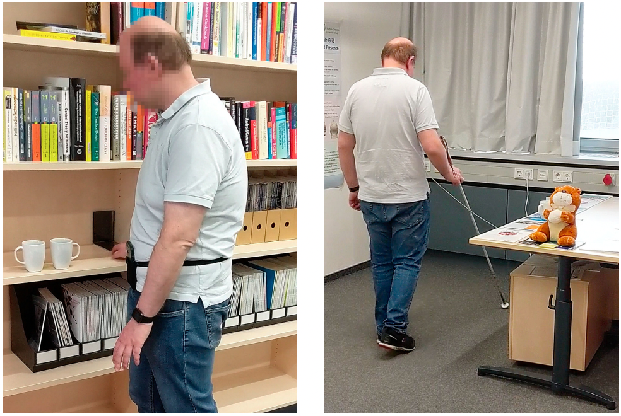
Brief Review Our Product
An ios application can help blind people to avoid collision.
Which will be based on ARKit and using audio feedback.
Picture cited from:
[1]Kaul, O.B., Behrens, K. and Rohs, M., 2021, May. Mobile Recognition and Tracking of Objects in the Environment through Augmented Reality and 3D Audio Cues for People with Visual Impairments. In Extended Abstracts of the 2021 CHI Conference on Human Factors in Computing Systems (pp. 1-7).

Slide 3
This Sprint Goals
Compare different methods to implement detection job
Literature review
Test open sources

Slide 4
Different Methods
Wearable ultrasonic echolocation system
[1]Capelle, C., Trullemans, C., Arno, P. and Veraart, C., 1998. A real-time experimental prototype for enhancement of vision rehabilitation using auditory substitution. IEEE Transactions on Biomedical Engineering, 45(10), pp.1279-1293.
SLAM
[3]Fusco, G. and Coughlan, J.M., 2020, April. Indoor localization for visually impaired travelers using computer vision on a smartphone. In Proceedings of the 17th International Web for All Conference (pp. 1-11).
2010
NOW
1998
2020
Camera-based
[2]Dunai, L., Fajarnes, G.P., Praderas, V.S., Garcia, B.D. and Lengua, I.L., 2010, November. Real-time assistance prototype—A new navigation aid for blind people. In IECON 2010-36th Annual Conference on IEEE Industrial Electronics Society (pp. 1173-1178). IEEE.
ARKit + Deep Learning

Slide 5

Things Need To Be Figure Out
How can I know where the obstacle is?
How can I know the distance between the obstacle and me?
How can ARKit help me since I already can do the detection with images?
How to build the architecture of the application?
Where my model should be? The server or the mobile devices?

Slide 6
Things Need To Be Figure Out
How can I know where the obstacle is?
How can I know the distance between the obstacle and me?
How can ARKit help me since I already can do the detection with images?
How to build the architecture of the application?
Where my model should be? The server or the mobile devices?

Slide 7
Why ARKit (what others have tried?) —AR Scene
Using camera to capture images, then put them into deep learning algorithms.
Recognized items can be placed in the scene at a certain depth detected by the AR framework.
Placing objects that the algorithm detected into AR scene being able to use the objects as landmarks, even if the user turns away from the object or the object is no longer detected in subsequent frames.
[1]Kaul, O.B., Behrens, K. and Rohs, M., 2021, May. Mobile Recognition and Tracking of Objects in the Environment through Augmented Reality and 3D Audio Cues for People with Visual Impairments. In Extended Abstracts of the 2021 CHI Conference on Human Factors in Computing Systems (pp. 1-7).

Slide 8
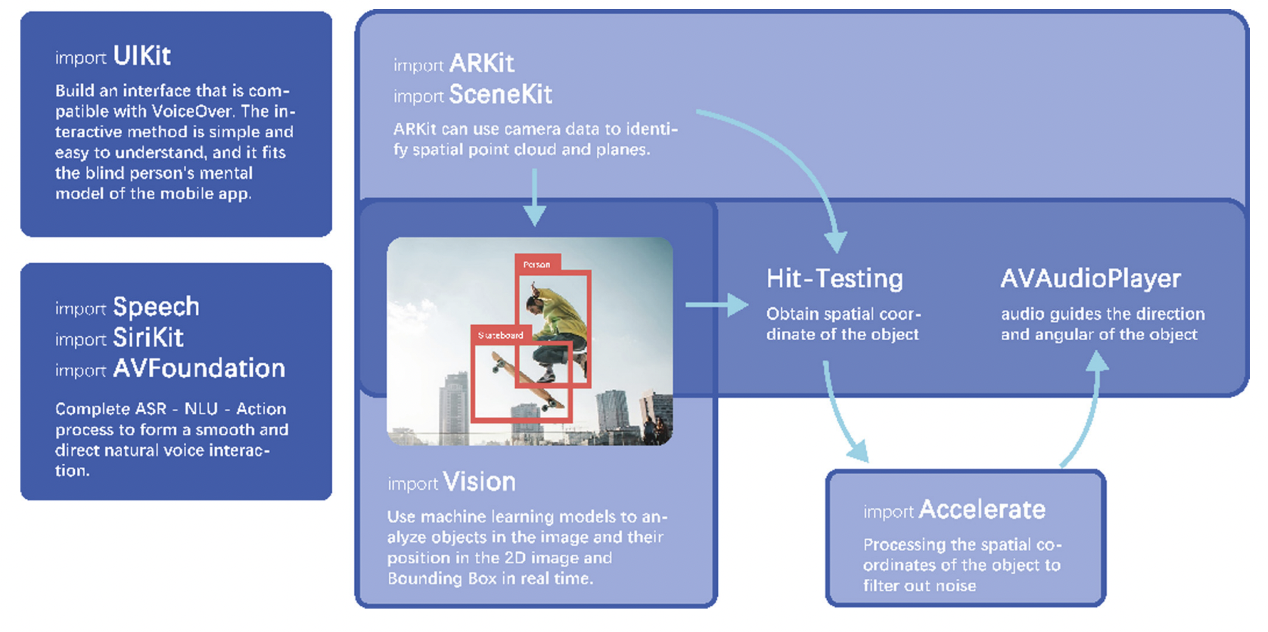
Why ARKit (what others have tried?) —Hit-Testing(raycastQuery)
[1]Shen, J., Dong, Z., Qin, D., Lin, J. and Li, Y., 2020, July. iVision: an assistive system for the blind based on augmented reality and machine learning. In International Conference on Human-Computer Interaction (pp. 393-403). Springer, Cham.

Slide 9
Open sources
Testing

Slide 10
Sprint3 Goals
Building the application
Test different detection algorithm
Do some tests of ARKit

Slide 11
Datasets That Maybe I Will Use
●Original point cloud data sets:
1. Cornell RGBD datasets 2.VMR-Oakland dataset 3.KITTI dataset 4.Robotic 3D Scan Repository
●Indoor 3D datasets:
1. Princeton modelnet https://modelnet.cs.princeton.edu/
2. NYU Depth Dataset V2 https://cs.nyu.edu/~silberman/datasets/nyu_depth_v2.html
●Outdoor 3D datasets:
1. KITTI https://www.cvlibs.net/datasets/kitti/
2. PandaSet https://scale.com/open-av-datasets/pandaset

Slide 12
References
[1]Kaul, O.B., Behrens, K. and Rohs, M., 2021, May. Mobile Recognition and Tracking of Objects in the Environment through Augmented Reality and 3D Audio Cues for People with Visual Impairments. In Extended Abstracts of the 2021 CHI Conference on Human Factors in Computing Systems (pp. 1-7).
[2]Capelle, C., Trullemans, C., Arno, P. and Veraart, C., 1998. A real-time experimental prototype for enhancement of vision rehabilitation using auditory substitution. IEEE Transactions on Biomedical Engineering, 45(10), pp.1279-1293.
[3]Shen, J., Dong, Z., Qin, D., Lin, J. and Li, Y., 2020, July. iVision: an assistive system for the blind based on augmented reality and machine learning. In International Conference on Human-Computer Interaction (pp. 393-403). Springer, Cham.
[4]Fusco, G. and Coughlan, J.M., 2020, April. Indoor localization for visually impaired travelers using computer vision on a smartphone. In Proceedings of the 17th International Web for All Conference (pp. 1-11).
[5]Kayukawa, S., Higuchi, K., Guerreiro, J., Morishima, S., Sato, Y., Kitani, K. and Asakawa, C., 2019, May. Bbeep: A sonic collision avoidance system for blind travellers and nearby pedestrians. In Proceedings of the 2019 CHI Conference on Human Factors in Computing Systems (pp. 1-12).
[6]Kuribayashi, M., Kayukawa, S., Takagi, H., Asakawa, C. and Morishima, S., 2021, May. Linechaser: a smartphone-based navigation system for blind people to stand in lines. In Proceedings of the 2021 CHI Conference on Human Factors in Computing Systems (pp. 1-13).

Slide 13
References
[7]https://developer.apple.com/documentation/vision
[8]https://developer.apple.com/documentation/coreml
[9]https://developer.apple.com/cn/documentation/
[10]https://github.com/r4ghu/iOS-CoreML-Yolo

Slide 14
Thank you

